Slide 1
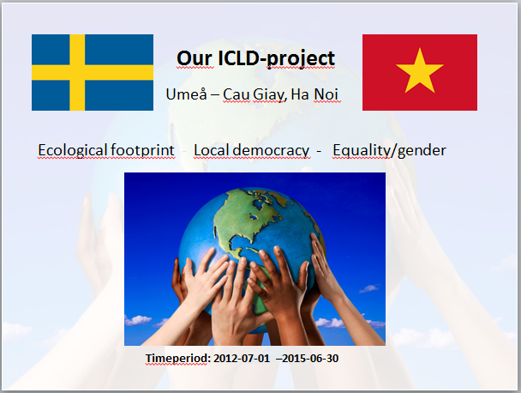

Slide 2
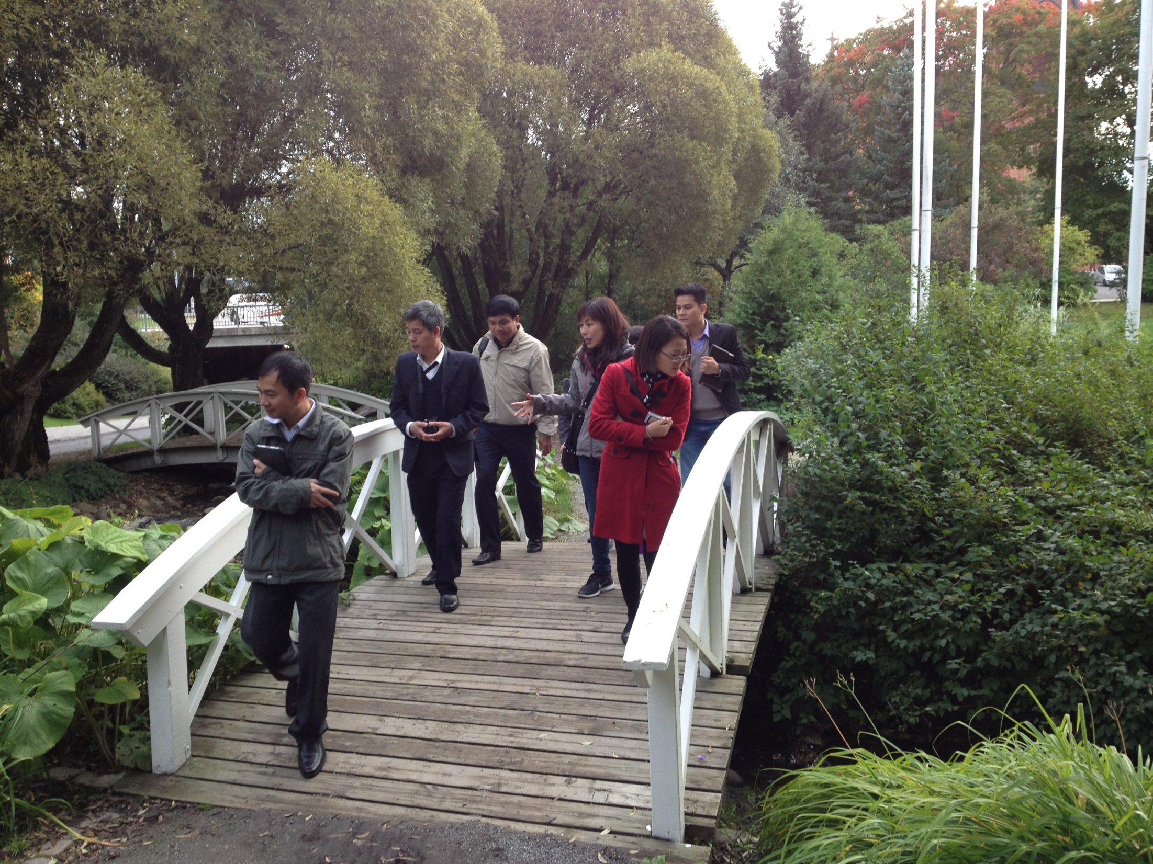

Slide 3
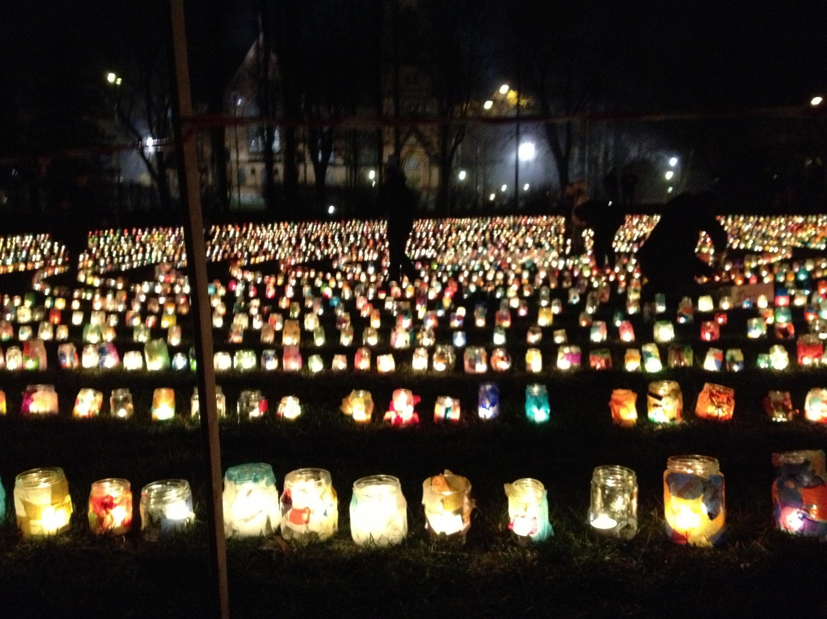

Slide 4
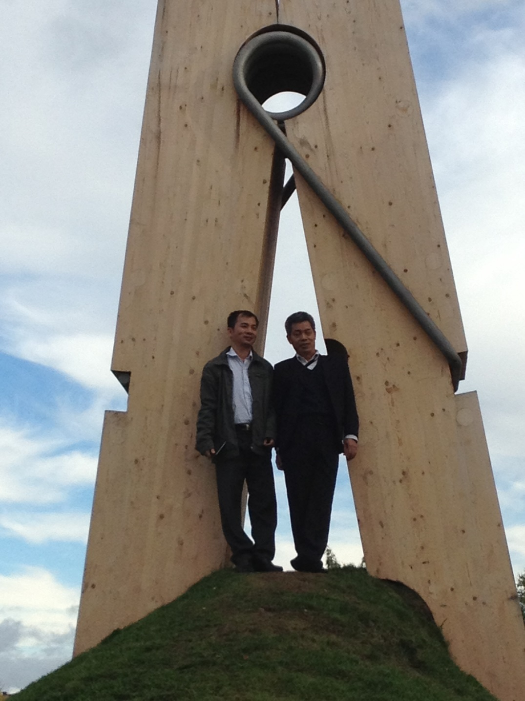
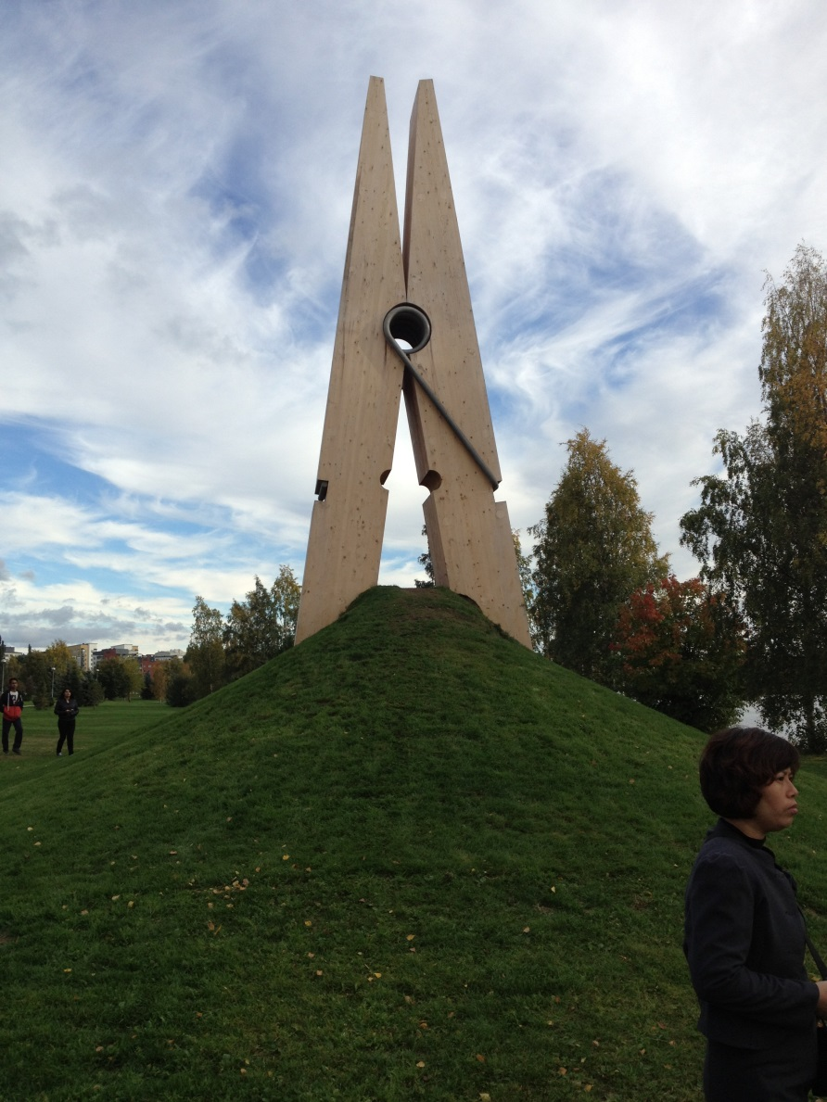

Slide 5
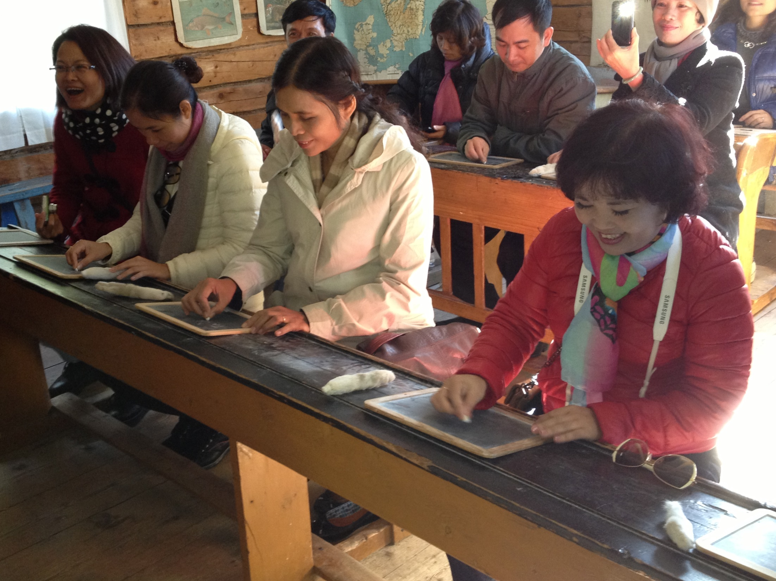

Slide 6
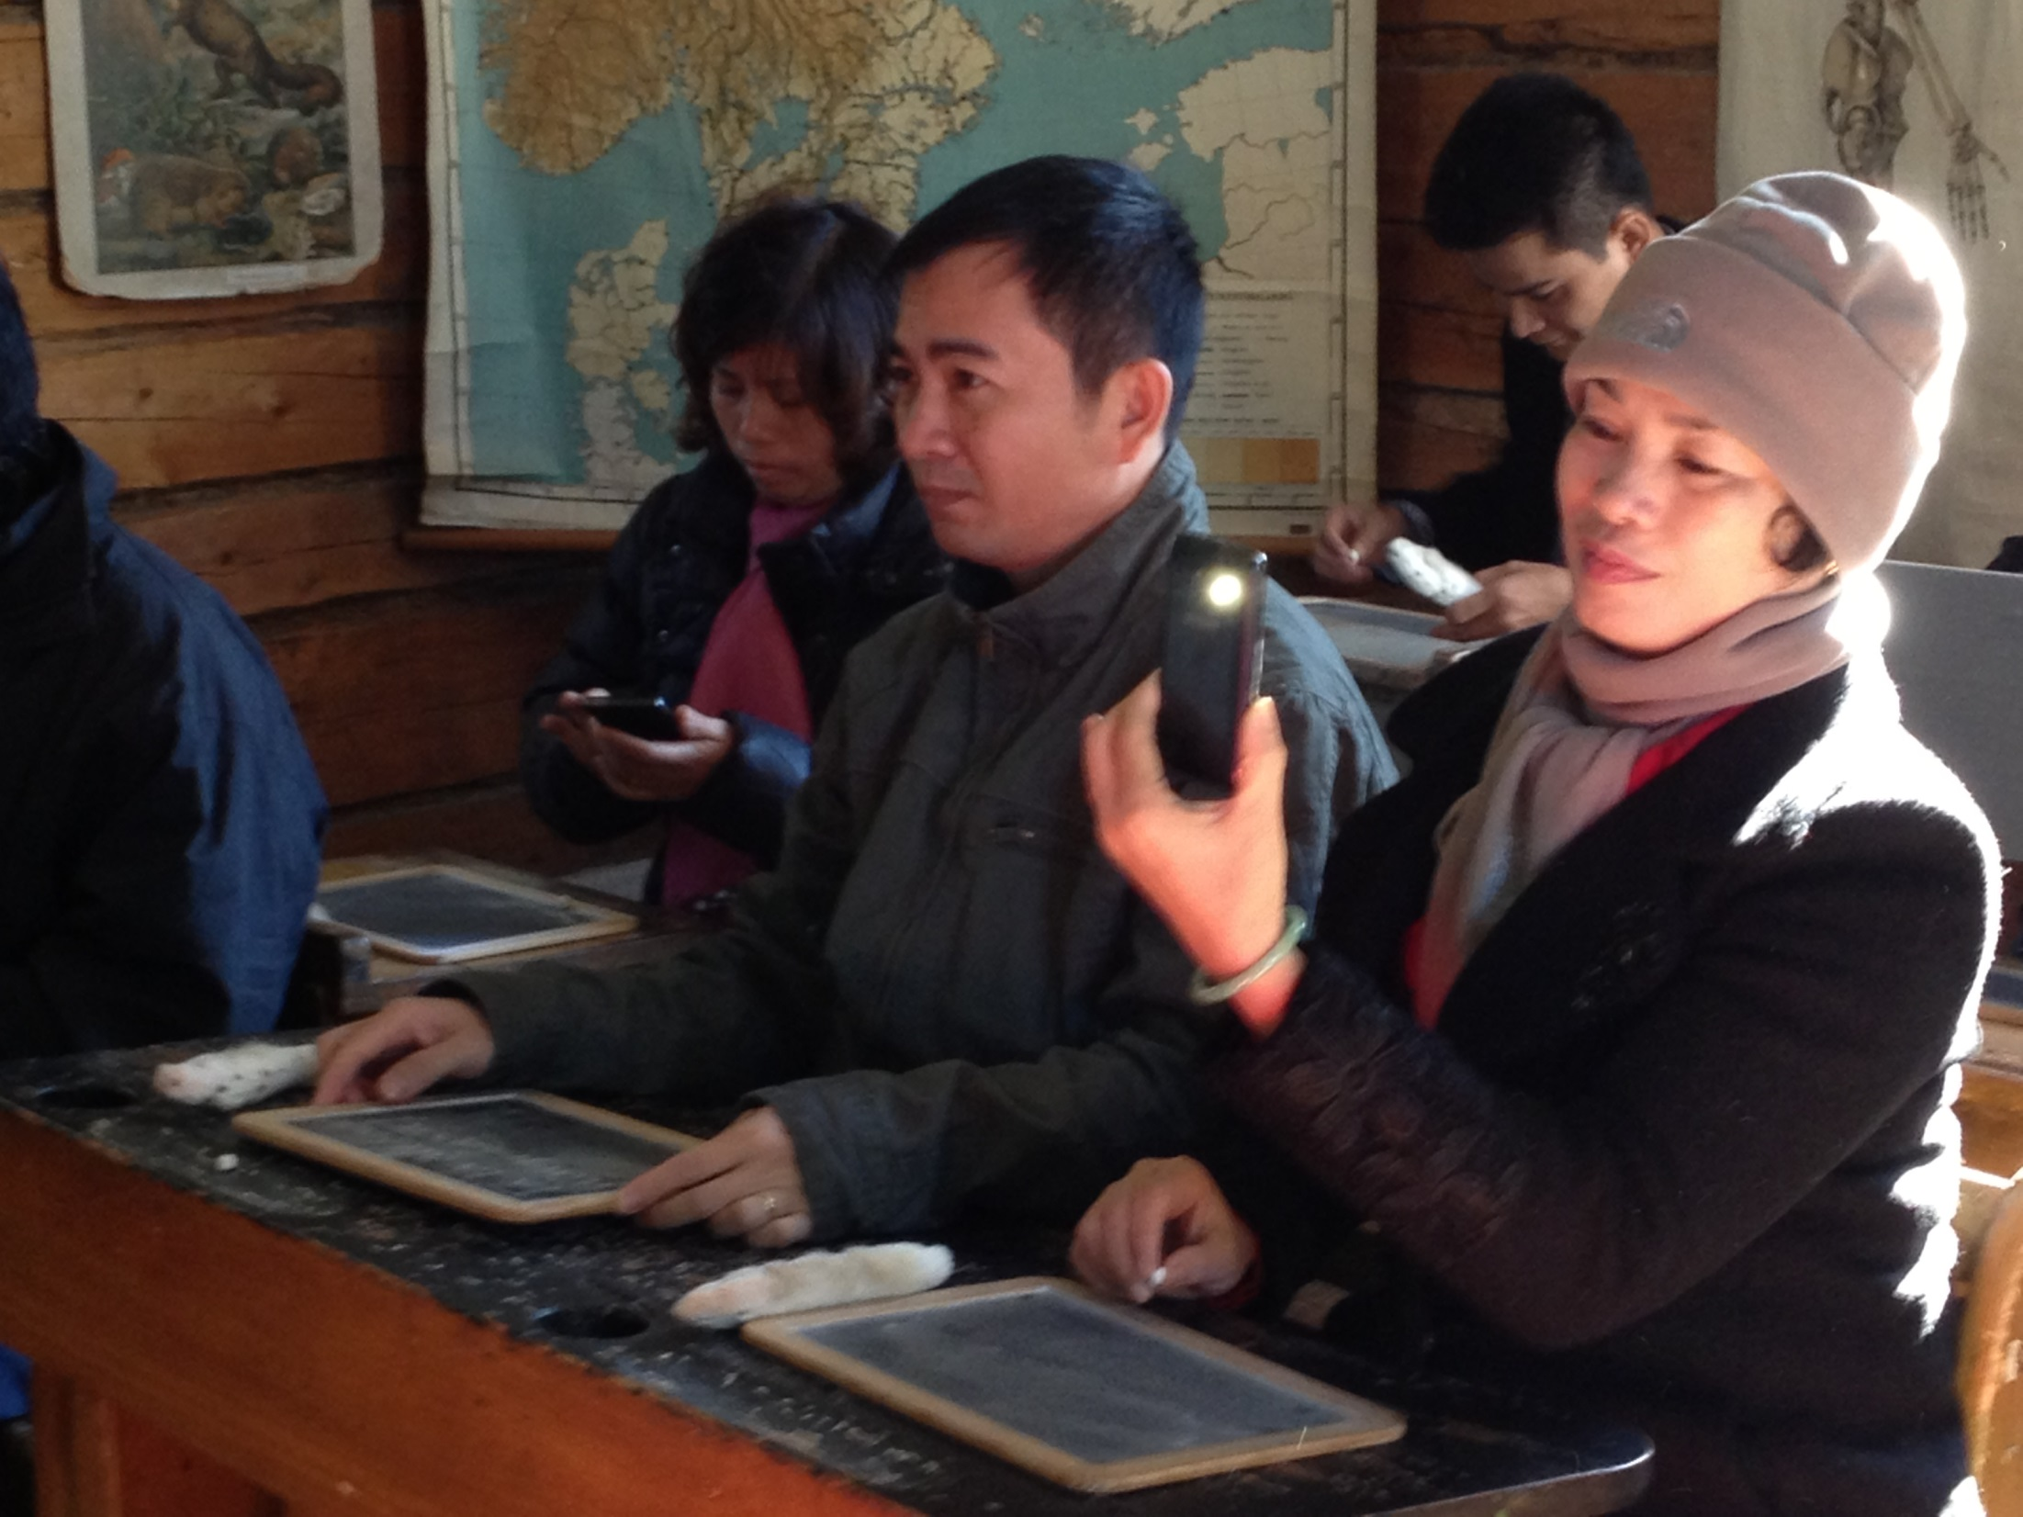

Slide 7
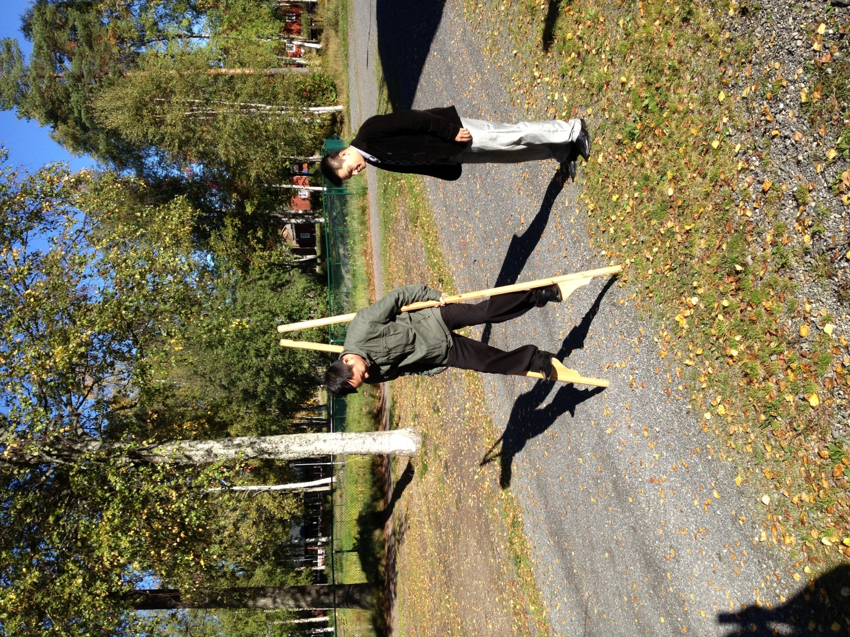
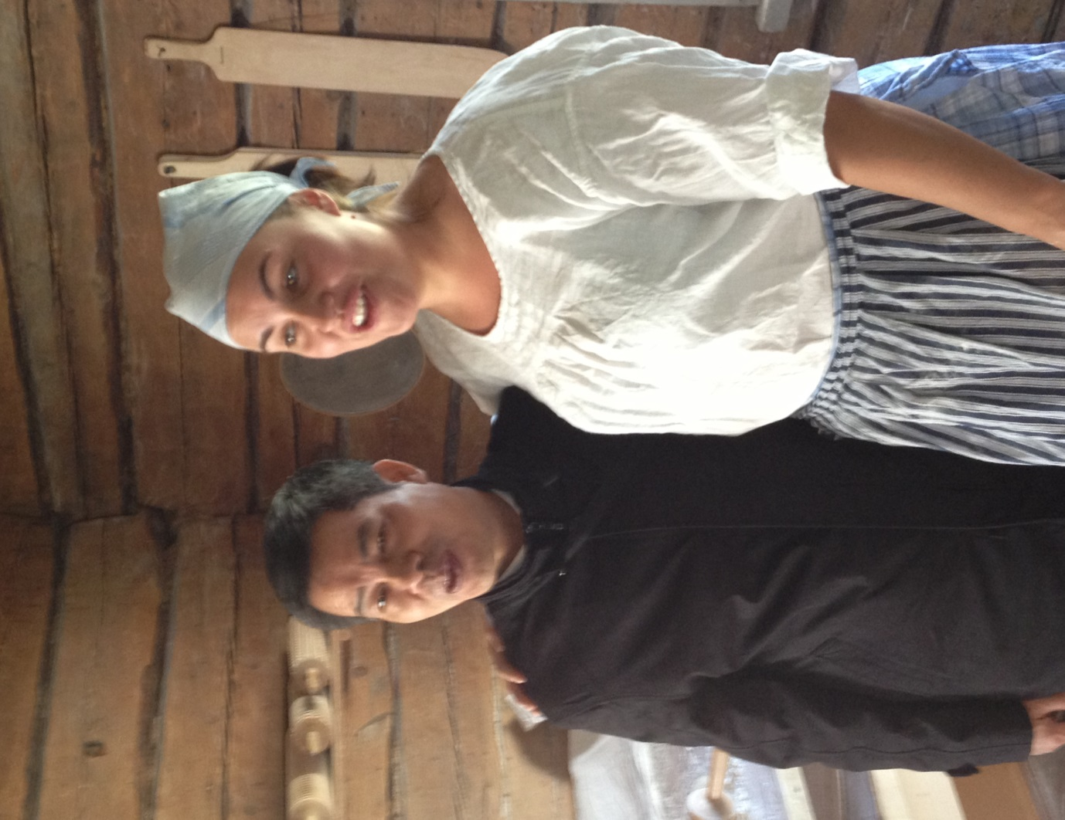

Slide 8



Today’s programme
Presentations
The ICLD project
Swedish education
What has happened in schools, preschool and in our districts/ciyt since our last meeting in Hanoi in febr 2013
Reflections
Experiences and reflections from teacher and princpal education in Hanoi – aug 2013
Preparation
Preparation for Tuesday study visits at the partner schools

Slide 9
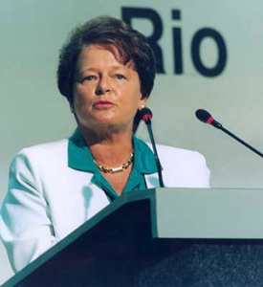
”Our common future”
”Sustainable development is development that meets the needs of the present without compromising the ability of future generations to meet their own needs.”
Gro Harlem Brundtland,
World Commission on Environment
and Development

Slide 10
Our ICLD-project Approach
”Capacitybuildning on an institutional level”
The DOET will learn the method of how Umeå is working with Education for Sustainable Development
Umeå will learn the method of how Cau Giay is working with ESD
Mutual understanding of eachothers methods

Slide 11
The school and preschool project Integrated Management Processes for ESD (Dnr 2012-0019)
Specific objectives for this project are the following;
to expose teachers, staff and pupils for ESD-work in another country
to, in a joint effort between schools in Umeå and Hanoi, communicate this collaboration on different platforms in both cities and countries
to, and most important; give input from a school perspective to the collaborating parties in the strategic project, in order for making school management sensitive to conditions and needs at the school level were teachers, other staff and pupils interact.

Slide 12
The strategic project Sustainable Strategies for Sustainable Education (Dnr 2012-0018)
Specific objectives for this project are the following;
to enhance competence within both organizations in order for improving their capacity to advocate for ESD in their own cities,
to support efforts in the partner organizations in order to improve their capacity to advocate for ESD in their own cities
to develop strategic plans for ESD in both of the partner organizations, which are focused on short, medium and long-term change and results

Slide 13
Management and Coordination (Dnr 2012-0020)
Specific objectives for this project
to give guidelines to coordinators/project managers and project-leaders, learn and communicate, follow-up and evaluate.

Slide 14
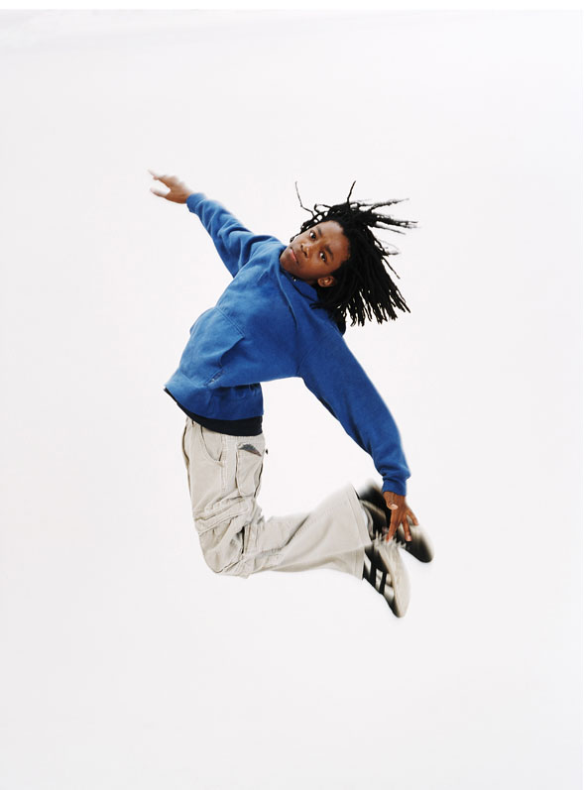
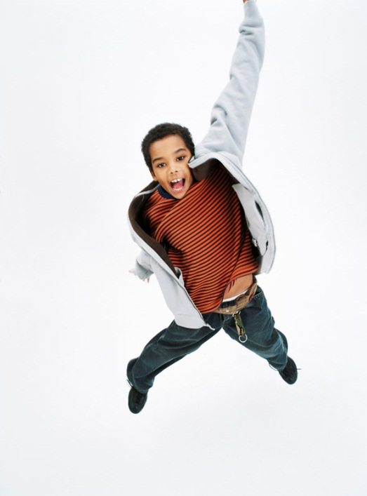




Swedish Education

Slide 15

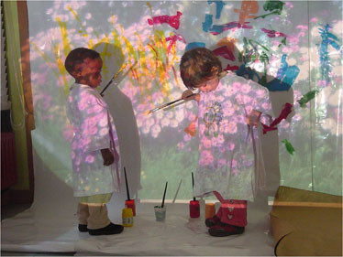
Swedish education
From preschool onwards, Swedes are encouraged to think independently. It’s one way Sweden maintains its long and proud tradition of innovation.
This innovative spirit can be seen in the fact that Sweden consistently tops European rankings in terms of research investments as a percentage of GDP and in the number of published scientific works per capita.

Slide 16
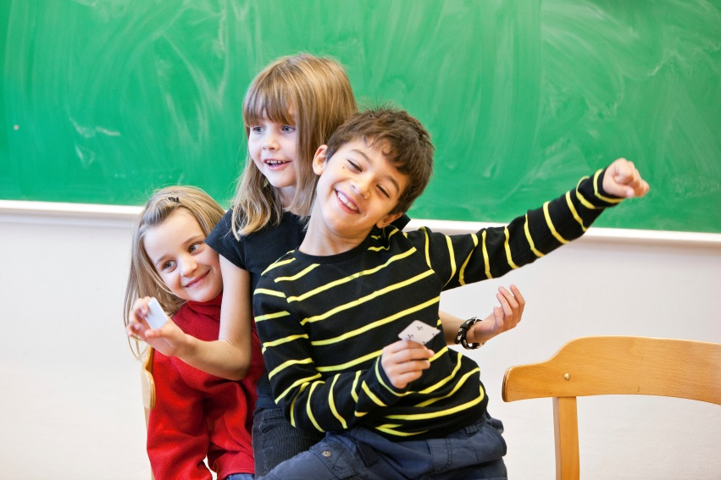

The educational system is based on tax-financed education for all.
The Education Act states that children in need of special assistance at school should receive it.
The law also says there must be equality in education for all children, wherever they live in Sweden and regardless of ability or disability.

Slide 17
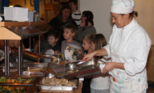
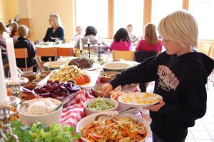
Education is compulsory for all children aged seven to 16, although nearly all start at age six.
Most of the responsibility for education rests with local municipalities.
The majority of the education budget is financed by local taxes, and approximately half of the municipal budget is spent on education.
Today Sweden and Finland are the only two countries that still provide a free lunch for all pupils.

Slide 18
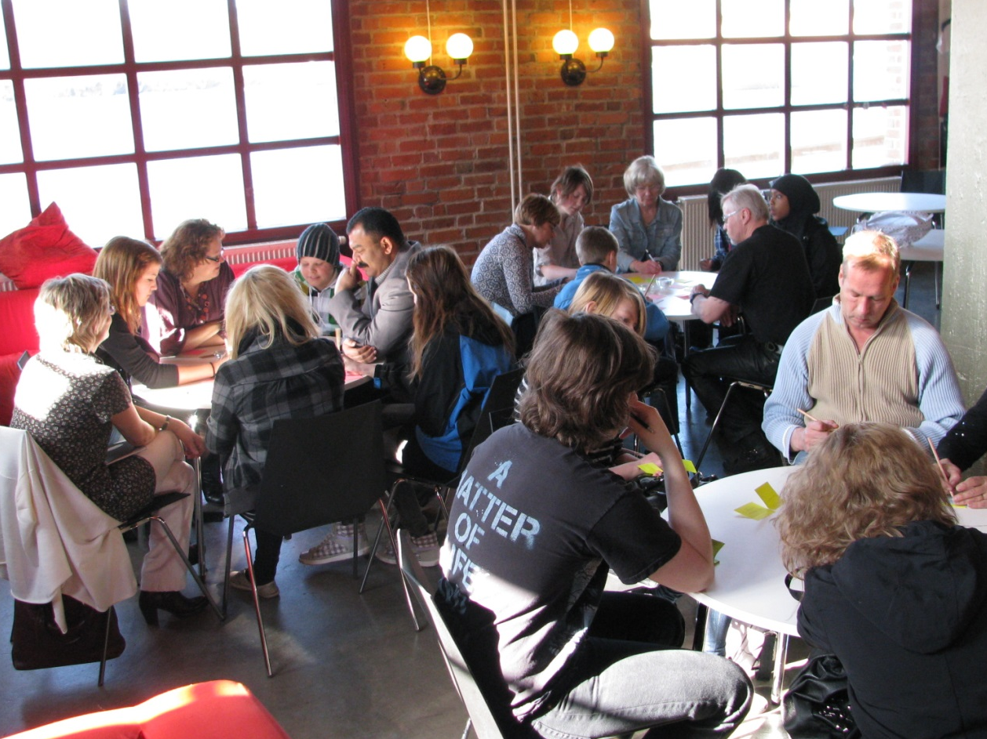
In Sweden, where equality, democracy and children’s rights are cherished, education is always a hot topic.
Issues such as the growth of private schools, awarding grades to elementary school children, and education for the children of recent immigrants are rarely out of the headlines.

Slide 19
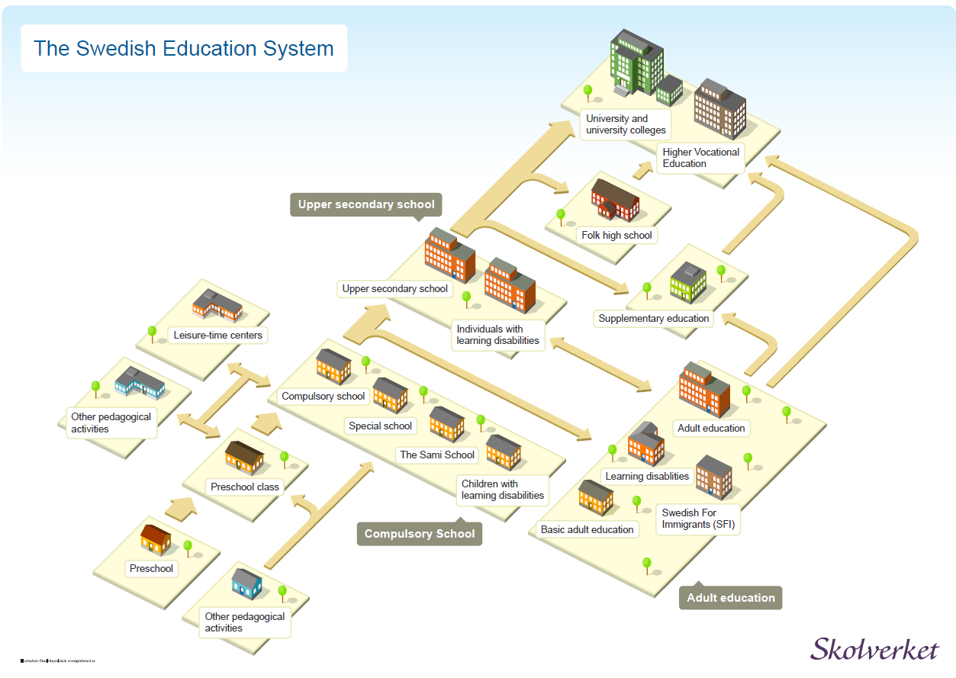

Slide 20

The Swedish Educational System for 1 - 19 year olds
Preschool classes
voluntary
Upper Secondary School
3 year voluntary edcucation
Pre-school or
family day-care
Compulsory schools
Years 1 - 9 compulsory education
1 year
5 years
7 years
16 years
After School Care
Leisure centres, youth clubs and family day-care centres
6 - 12 years

Slide 21

New education act
The Swedish Education Act from 2011 contains basic principles and provisions for compulsory and further education, preschool, out-of school care and adult education.
It promotes chidrens right to knowledge, freedom of choice, and student safety and security
Sweden was the first country in the world to prohibit corporal punishment of children, in 1979, and, in 1990, was one of the first to sign the United Nations Convention on the Rights of the Child.

Slide 22
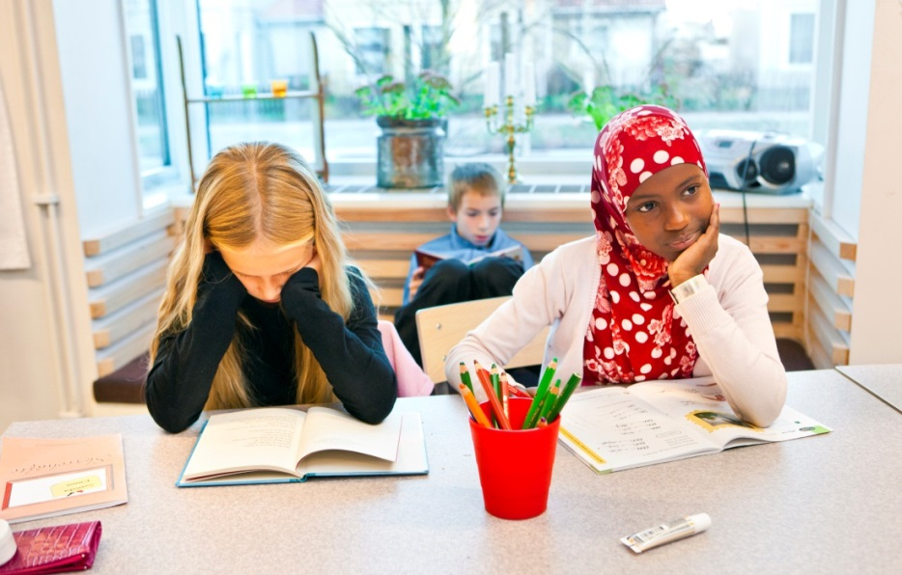
New curricula
The curricula contain new general goals, guidelines and syllabuses. The preschool curriculum includes clearer goals for children’s linguistic and communicative development and for science and technology.
Mandatory national subject tests are held in years 3, 6 and 9 of compulsory school to assess student progress.

Slide 23
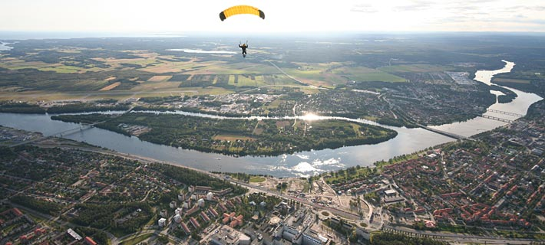
Umeå

Slide 24
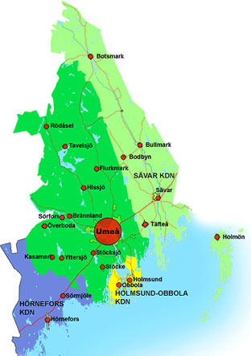
has
13 schools disticts
13 skolområden
Marie
Tomtebo
Teg
Västra
Ersboda
Ålidhem
Röbäck
Grubbe
Sävar
Hörnefors
Centrala
Haga
Holmsund-
Obbola

Slide 25

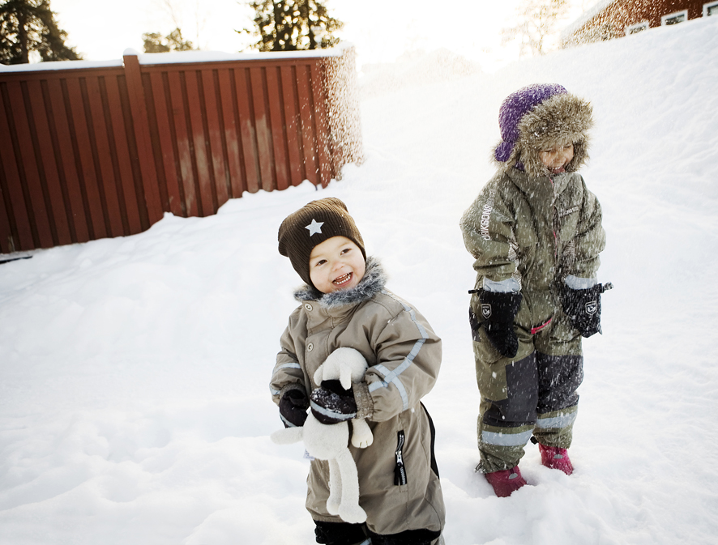

Foto: Malin Grönborg
För- och grundskolor
Förskolor 90 kommunala 23 enskilda
Grundskolor 50 kommunala 7 fristående
Preschools
90 municipality 23 indipendent
Compulsary schools
50 municipality
8 independent

Slide 26
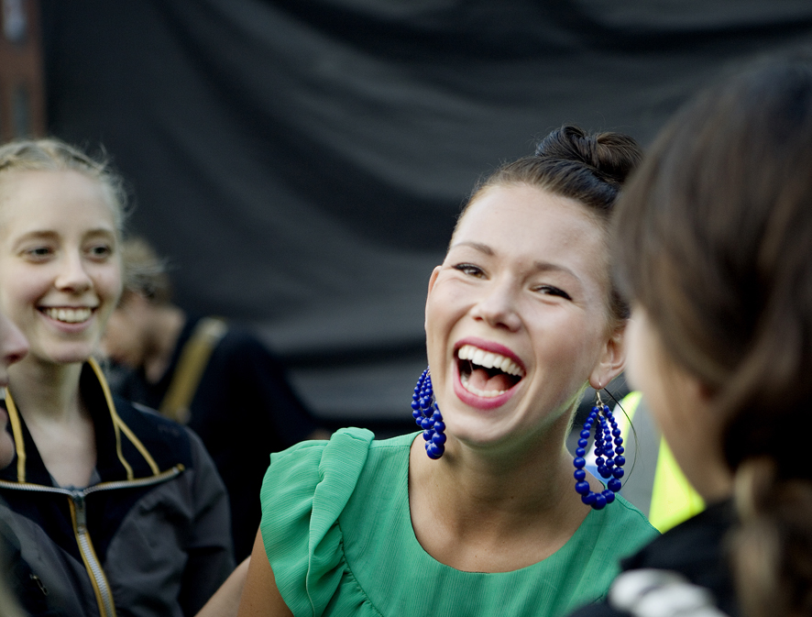

Photo: Malin Grönborg
Upper secondary schools
4 municipal
6 independent

Slide 27

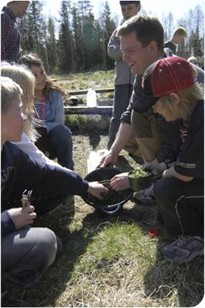
City Council of Pre-school
and Compulsory School Board
Education for sustainable development should permeate all activities. The mission to educate for sustainable development have been formulated in international agreements and national policy documents.
Children pupils and staff in Umeå will help and contribute to sustainable development and sustainable learning .
The work in schools and preschols will be developed in accordance with the objectives of the award "School for Sustainable Development
Municipality mission plan

Slide 28
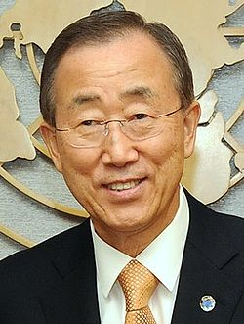
Sustainable development
“We hold the future in our hands, together, we must ensure that our grandchildren will not have to ask why we failed to do the right thing, and let them suffer the consequences.”
UN Secretary-General
Ban Ki-moon, 2007

Slide 29

If I do something And you do something
We´ll make difference together!

Slide 30
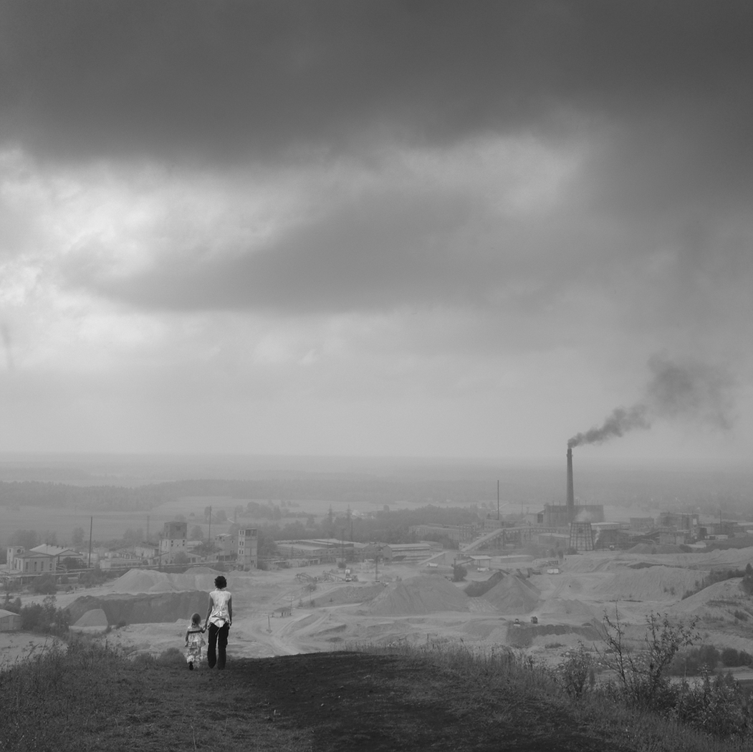
Or not......

Slide 31

Knowledge + values = Action
= Change of behaviour

Slide 32


Achivable goals, resorces, common learning , evaluate, support
Support and communicate
Enhance competence in order for improving capacity to advocate for ESD in our own cities
Support and communicate
Communicate this collaboration on different platforms
Expose teachers, staff and pupils in ESD-work
Communicate this collaboration on different platforms

Slide 33
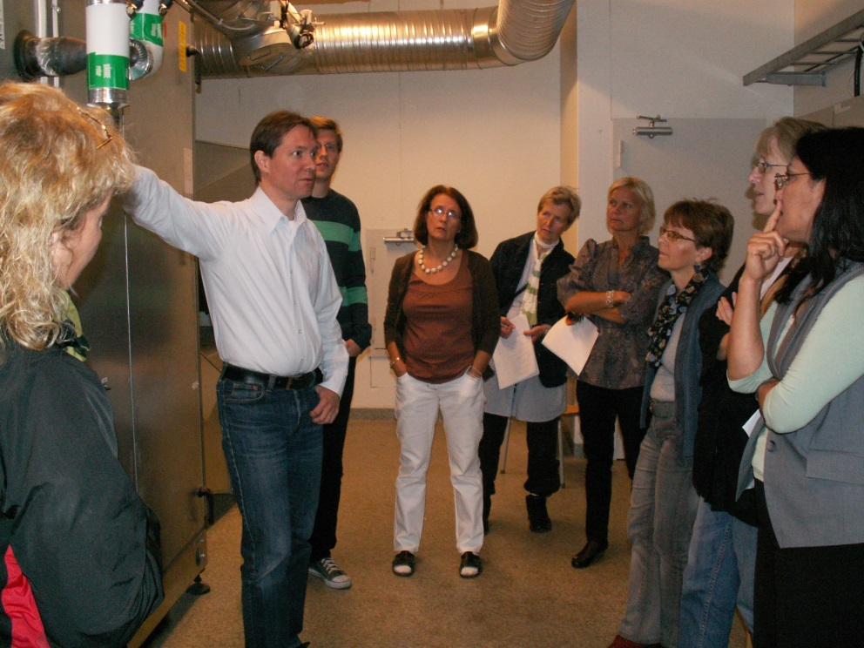
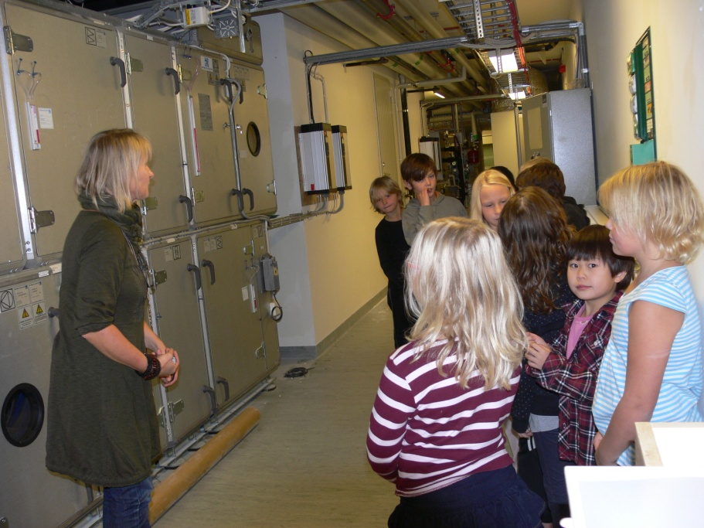
How to save energy - education for teachers and pupils!

Slide 34
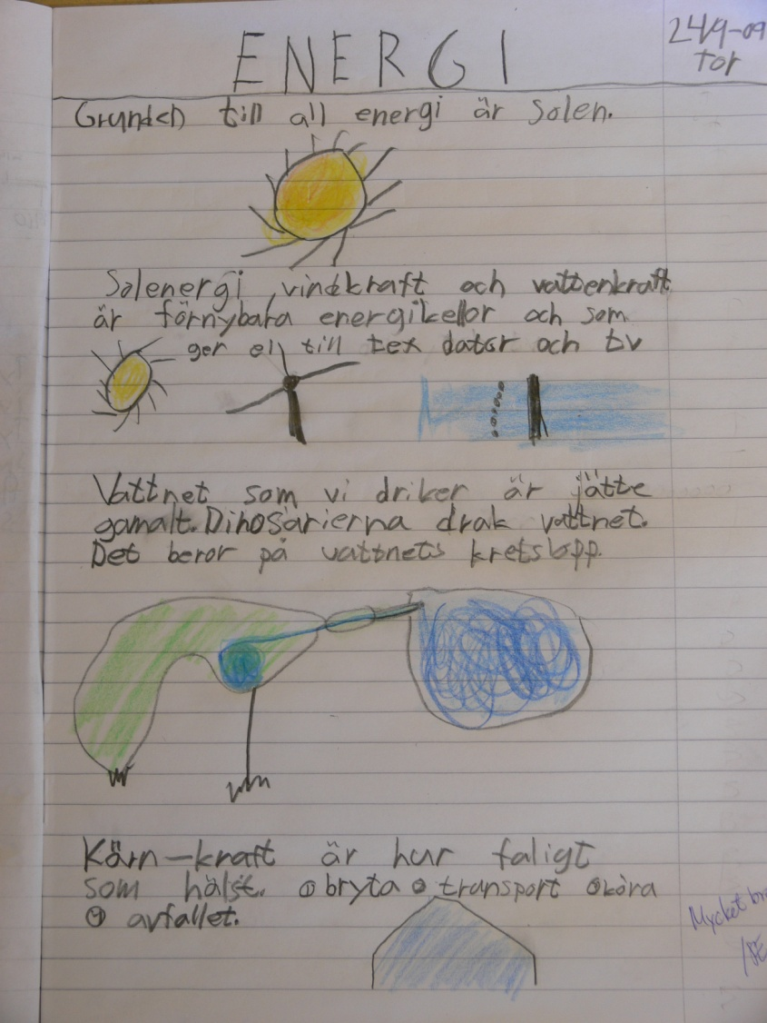
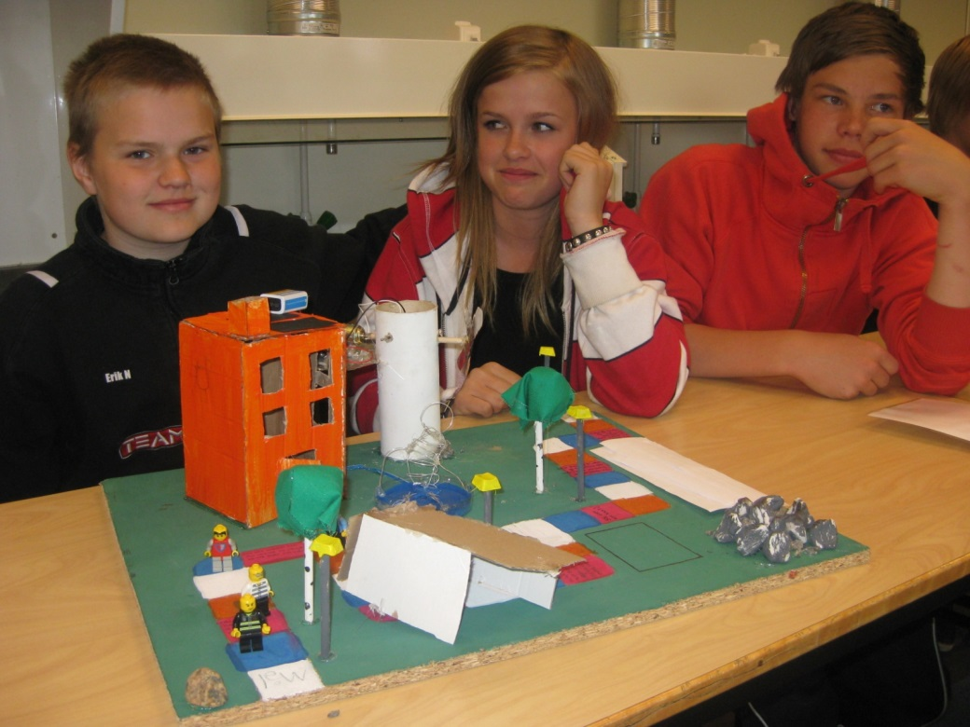
For different ages

Slide 35
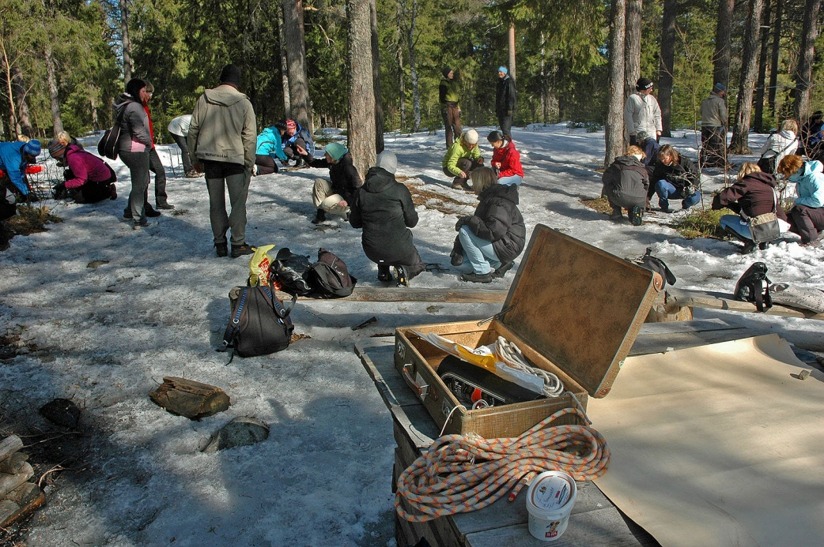
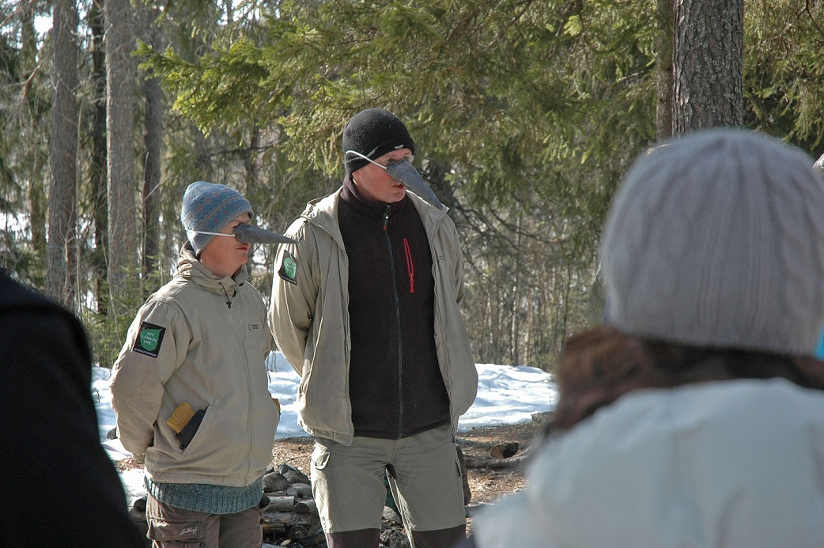
Outdoor education in mathematics

Slide 36
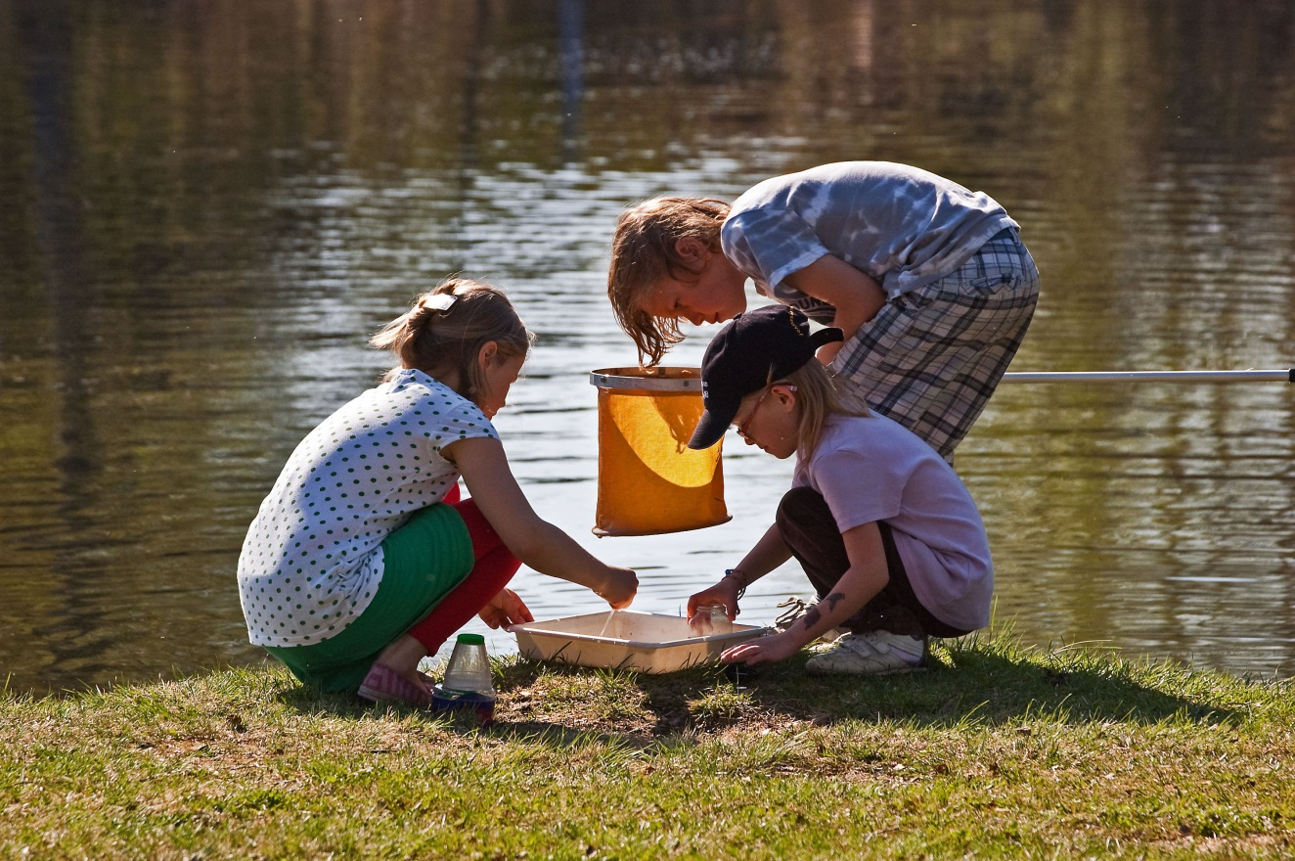
Exam what´s in the lake

Slide 37
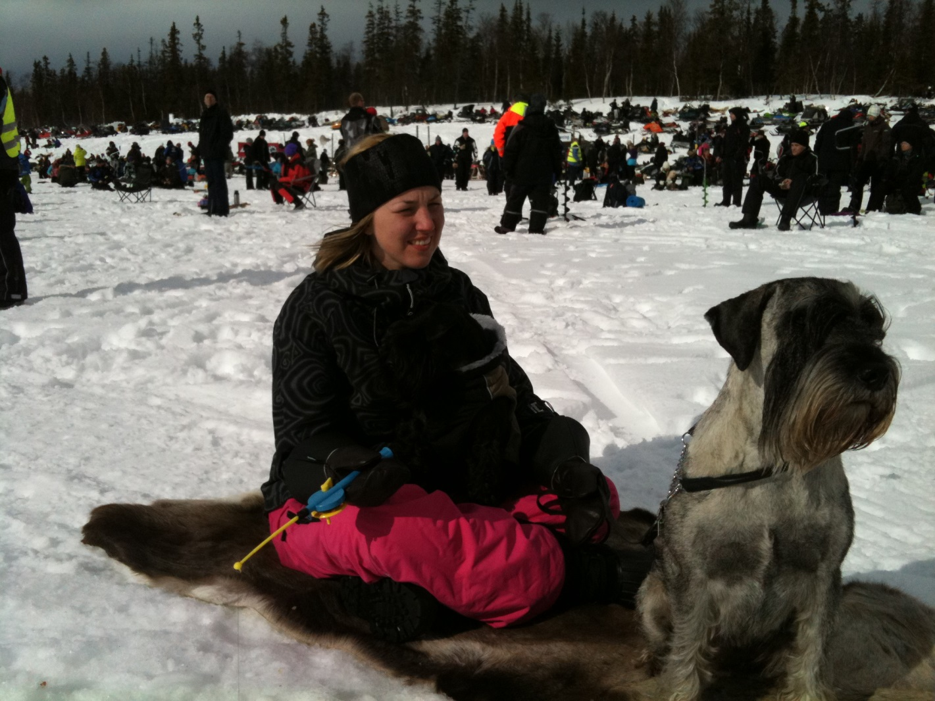
Fishing in a frozen lake

Slide 38
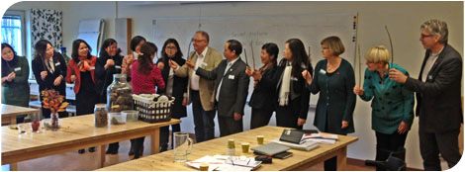
Collaboration and laughs

Slide 39

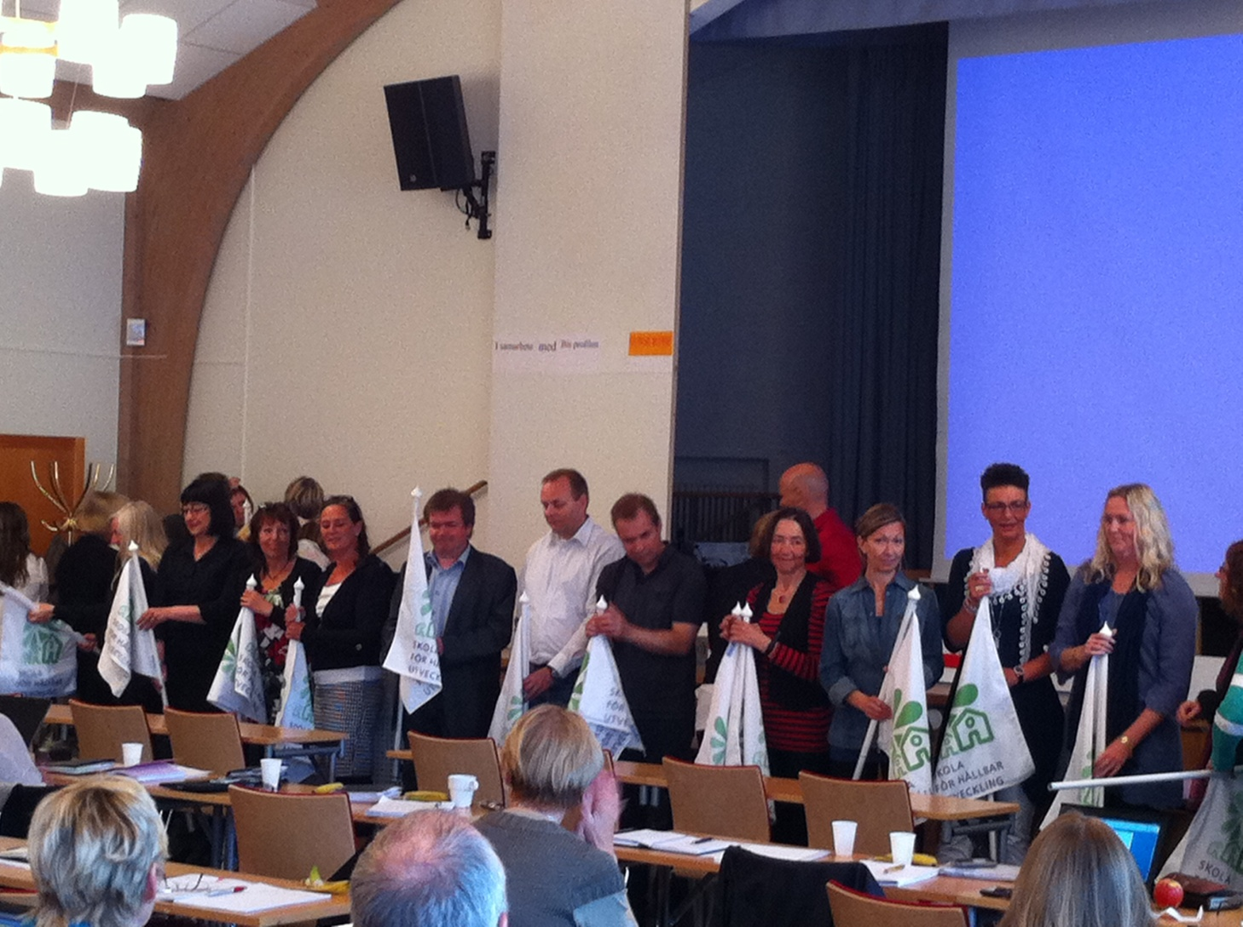
Principals celebrating in 2010

Slide 40
What has happened in Umeå in the strategic level
since our last meeting
Support to more schools and preschools with working to apply and reapply for the award ¨School of sustainible development¨
ESD refererence group is established with pincipals and teachers from preschools and schools (10 persons)
ESD network is estabished (ca 200 teachers and preschool teachers)
Kick off for all teachers in the compulsary schools
Planning for a big conferece for the network in november in cooperation with The Global School
- Methods of ESD

Slide 41
Network ESD
School distict leaders and Directors of school
Proposal -
Strategic plan
Reference group
School
Prechool
School
Prechool
School
School
School
Prechool
School
Prechool
Prechool
Prechool
School

Slide 42
Preparing Action plan for ESD together with prinipals in Umeå
Contacts with UMEVA of collaborating in the ICLD project
Ungoing international ESD project with Malaysia Dubai and China
Initial contacts with Kenya for future ESD-project.
Media interest of teacher education in Hanoi

Slide 43



International cooperation on local level between the City of Umeå, and Cau Giay District, Hanoi
Ecological footprint
Local democracy
Equality/gender
Meeting in Umeå 21/9 – 26/9 2013

Slide 44
Summary up of the programme 21/9 – 26/9 2013
Presentations of activities and achevements in our partner schools and in the district/city
Study visits at the partner schools
discussions of what we have been seeing in schools and preschools focusing ESD, gender and local democracy
Information from UMEVA and visit at a recycling station
Information from Umeå Energi and a study visit at Dåvamyra
Outdoor education
Project meetings with parter schools and in the strategy group
Social activities

Slide 45
Achivements from the project meetings
Activityplans for the partner schools
Communication plan for the partner schools
Preparation meetings in Cau Giay and in Umeå for examine the intrest and posibility för cooperation beetween UMEVA and counterpart department in Cau Giay
Prparation meetings in Cau Giay and Umeå for examine if it is an interest and if it´s possible to make an information and training course for leaders and politicians in Cau Giay in febr 2014.
Areas of support beetween Dot and district leaders in Umeå
Communication plan for the strategic level, DOET - Umeå

Slide 46
Group discussion about the certification:
Work with very good. We have some activities related to cerification bot not the work with ESD. We will discuss with DOET and schools of criterias. Difficult – many levels. Starting point. Share suggstions of criterias in febr.
Really good. Learn the criterias. DOET:s. More information in febr. we ursually work in schoolyear. Different criterias for primary, secondary and kindergarten. Like to learn more of innehållet. Fråga: vad äe nivåerna. Kriteriet

Slide 47
And now.....
Evaluation time

